Slide 1

Random Forest & Decision Tree Classifiers

Slide 2
What is a Decision Tree Classifier?
A Decision Tree Classifier is a supervised learning model used for classification and regression problems. It predicts the value of a target variable by learning simple decision rules inferred from data features.
How it Works (Core Idea):
The tree is built by splitting the dataset into subsets based on the value of input features.
Each internal node represents a decision based on a feature, each branch a possible outcome, and each leaf node a final class label.

Slide 3
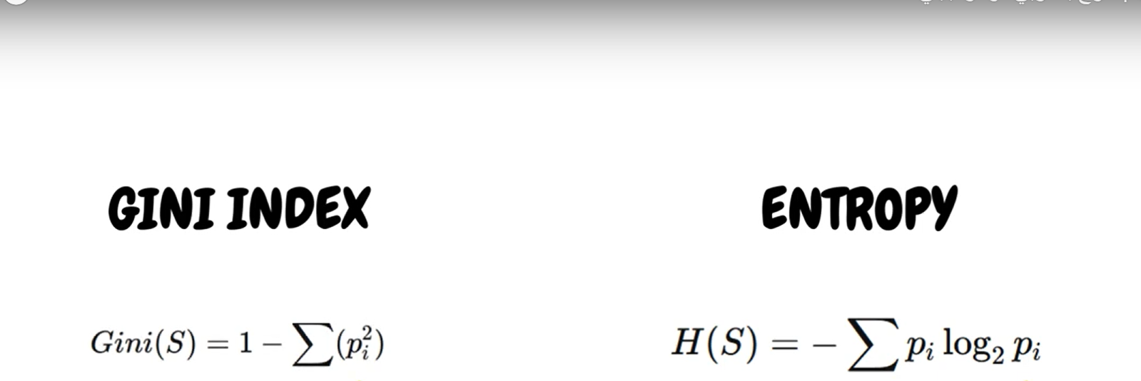
Splitting Criteria (How to choose the best split?)
At each node, the algorithm evaluates all possible splits and chooses the one that results in the purest children nodes.
Gini Index (Default in sklearn)
Measures impurity: how often a randomly chosen element would be incorrectly classified.
Formula:
fig1

Slide 4
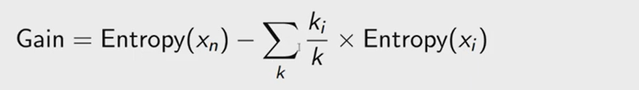
Splitting Criteria
2. Entropy (Information Gain)
Entropy measures the uncertainty (disorder) in the dataset.
Formula:
fig2
pi​ = probability of class i
The goal is to maximize information gain:
fig3

Slide 5
What is Entropy?
Entropy is a measure of impurity or randomness in the data. It helps decision trees determine the best feature to split on.
Low entropy = pure node (most samples belong to one class).
High entropy = impure node (samples are evenly spread across classes).

Slide 6
Entropy Values and What They Mean
Entropy Value | Meaning | Example
Entropy = 0 | Pure node | All samples belong to one class (e.g., all “Yes”)
Entropy = 1 | Maximum impurity | Equal distribution between classes (50% Yes, 50% No)
Entropy = 0.5 | Moderate impurity | Uneven distribution (e.g., 75% Yes, 25% No)

Slide 7
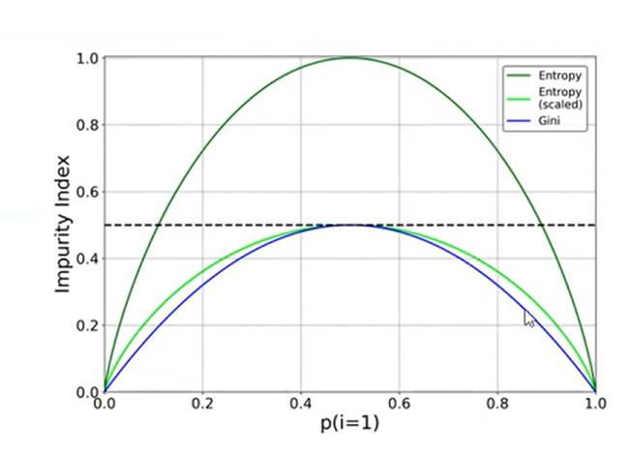

Entropy vs. Probability (Graph Description)
fig4

Slide 8
Why Use Decision Trees?
Easy to understand & visualize
Handles both numerical & categorical data
Requires little data preprocessing (no scaling needed)
Can easily capture non-linear patterns

Slide 9
Random Forest Classifier – Introduction
andom Forest is an ensemble learning method used for classification and regression.
It builds multiple decision trees and combines their results using majority voting (for classification).
Reduces overfitting and improves accuracy compared to a single Decision Tree.

Slide 10
How It Works
Bootstrap sampling: Random subsets of data are selected for training each tree.
Feature bagging: Random subset of features is chosen at each split.
Final prediction is made by majority vote across all trees.

Slide 11
Gini Impurity Details
Formula: Gini = 1 - ∑(pᵢ²)
Where pᵢ = probability of class i in the node.
Gini = 0 → pure node (only one class).
Gini near 0.5 → mixed node.
Gini closer to 1 → highly impure.

Slide 12
Entropy Details
Formula: Entropy = -∑(pᵢ * log₂(pᵢ))
Entropy = 0 → pure node.
Entropy = 1 (in binary class) → equally mixed classes.
Used in ID3 and some versions of C4.5 algorithms.

Slide 13
from sklearn.ensemble import RandomForestClassifier
model = RandomForestClassifier(criterion='gini') # or 'entropy'
model.fit(X_train, y_train)
preds = model.predict(X_test)

Slide 14
References
1-https://youtu.be/ucuumzF1vsY?si=wqHMzmkHV_V3RbIn
2-https://youtu.be/ucuumzF1vsY?si=wqHMzmkHV_V3RbIn
3- https://youtu.be/0TSOTNH3q0U?si=_41FUvkB31WVIvA4
4- https://youtu.be/EZtxh2Q0zVQ?si=VFl14GSQdxTiAwwa

